Slide 1
COGIMON URDF-DATA

Slide 2
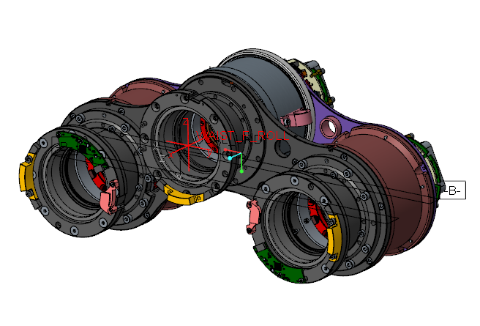
waist
VOLUME = 1.0924781e+06 MM^3
SURFACE AREA = 7.2290644e+05 MM^2
AVERAGE DENSITY = 3.1670623e-06 KILOGRAM / MM^3
MASS = 3.4599462e+00 KILOGRAM
CENTER OF GRAVITY with respect to WAIST_F_ROLL coordinate frame:
X Y Z -5.6796324e+01 4.5196345e-01 -3.8136153e+01 MM
INERTIA with respect to WAIST_F_ROLL coordinate frame: (KILOGRAM * MM^2)
INERTIA TENSOR:
Ixx Ixy Ixz 4.3163054e+04 1.8426740e+02 -7.5767018e+03
Iyx Iyy Iyz 1.8426740e+02 2.5169260e+04 6.8799877e+01
Izx Izy Izz -7.5767018e+03 6.8799877e+01 5.0812723e+04
INERTIA at CENTER OF GRAVITY with respect to WAIST_F_ROLL coordinate frame: (KILOGRAM * MM^2)
INERTIA TENSOR:
Ixx Ixy Ixz 3.8130318e+04 9.5451056e+01 -8.2481481e+01
Iyx Iyy Iyz 9.5451056e+01 8.9760596e+03 9.1637353e+00
Izx Izy Izz -8.2481481e+01 9.1637353e+00 3.9650845e+04
PRINCIPAL MOMENTS OF INERTIA: (KILOGRAM * MM^2)
I1 I2 I3 8.9757442e+03 3.8126172e+04 3.9655306e+04
ROTATION MATRIX from WAIST_F_ROLL orientation to PRINCIPAL AXES:
-0.00327 -0.99854 -0.05400
0.99999 -0.00329 0.00013
-0.00031 -0.05400 0.99854
ROTATION ANGLES from WAIST_F_ROLL orientation to PRINCIPAL AXES (degrees):
angles about x y z 0.000 -3.095 90.188
RADII OF GYRATION with respect to PRINCIPAL AXES:
R1 R2 R3 5.0933153e+01 1.0497284e+02 1.0705722e+02 MM

Slide 3
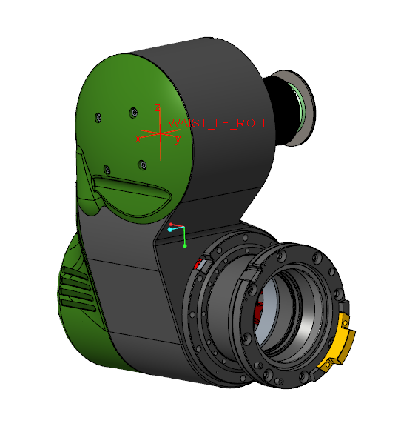
Hip roll
VOLUME = 6.2706035e+05 MM^3
SURFACE AREA = 4.5812857e+05 MM^2
AVERAGE DENSITY = 3.3388281e-06 KILOGRAM / MM^3
MASS = 2.0936467e+00 KILOGRAM
CENTER OF GRAVITY with respect to WAIST_LF_ROLL coordinate frame:
X Y Z -4.1435899e+01 -2.4099021e-01 -6.7437774e+01 MM
INERTIA with respect to WAIST_LF_ROLL coordinate frame: (KILOGRAM * MM^2)
INERTIA TENSOR:
Ixx Ixy Ixz 2.0328644e+04 1.2836757e+01 -7.1832791e+03
Iyx Iyy Iyz 1.2836757e+01 2.4404941e+04 2.2892687e+01
Izx Izy Izz -7.1832791e+03 2.2892687e+01 8.9864540e+03
INERTIA at CENTER OF GRAVITY with respect to WAIST_LF_ROLL coordinate frame: (KILOGRAM * MM^2)
INERTIA TENSOR:
Ixx Ixy Ixz 1.0806924e+04 3.3743172e+01 -1.3329083e+03
Iyx Iyy Iyz 3.3743172e+01 1.1288691e+04 5.6918305e+01
Izx Izy Izz -1.3329083e+03 5.6918305e+01 5.3916798e+03
PRINCIPAL MOMENTS OF INERTIA: (KILOGRAM * MM^2)
I1 I2 I3 5.0807373e+03 1.1114941e+04 1.1291616e+04
ROTATION MATRIX from WAIST_LF_ROLL orientation to PRINCIPAL AXES:
0.22676 0.96737 0.11303
-0.01016 -0.11370 0.99346
0.97390 -0.22642 -0.01595
ROTATION ANGLES from WAIST_LF_ROLL orientation to PRINCIPAL AXES (degrees):
angles about x y z -90.920 6.490 -76.808
RADII OF GYRATION with respect to PRINCIPAL AXES:
R1 R2 R3 4.9261958e+01 7.2862135e+01 7.3438931e+01 MM

Slide 4
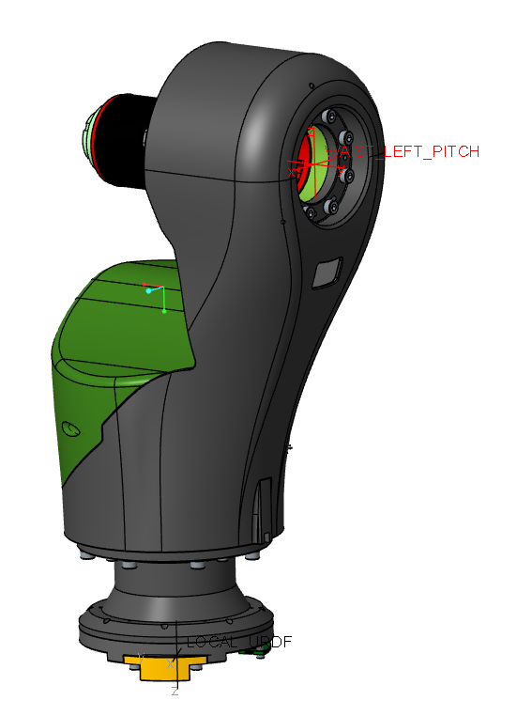
Hip - Pitch
VOLUME = 4.8843228e+05 MM^3
SURFACE AREA = 4.0853707e+05 MM^2
AVERAGE DENSITY = 3.2994721e-06 KILOGRAM / MM^3
MASS = 1.6115687e+00 KILOGRAM
CENTER OF GRAVITY with respect to WAIST_LEFT_PITCH coordinate frame:
X Y Z 5.8688639e-01 -6.2440385e+01 -8.5057072e+01 MM
INERTIA with respect to WAIST_LEFT_PITCH coordinate frame: (KILOGRAM * MM^2)
INERTIA TENSOR:
Ixx Ixy Ixz 3.4111563e+04 3.7170469e+01 1.4050574e+02
Iyx Iyy Iyz 3.7170469e+01 2.6097579e+04 -1.1276358e+04
Izx Izy Izz 1.4050574e+02 -1.1276358e+04 1.0209192e+04
INERTIA at CENTER OF GRAVITY with respect to WAIST_LEFT_PITCH coordinate frame: (KILOGRAM * MM^2)
INERTIA TENSOR:
Ixx Ixy Ixz 1.6169151e+04 -2.1886129e+01 6.0058109e+01
Iyx Iyy Iyz -2.1886129e+01 1.4437800e+04 -2.7173225e+03
Izx Izy Izz 6.0058109e+01 -2.7173225e+03 3.9254506e+03
PRINCIPAL MOMENTS OF INERTIA: (KILOGRAM * MM^2)
I1 I2 I3 3.2643786e+03 1.5097479e+04 1.6170543e+04
ROTATION MATRIX from WAIST_LEFT_PITCH orientation to PRINCIPAL AXES:
-0.00412 0.03306 -0.99944
0.23630 0.97118 0.03115
0.97167 -0.23604 -0.01182
ROTATION ANGLES from WAIST_LEFT_PITCH orientation to PRINCIPAL AXES (degrees):
angles about x y z-110.770 -88.091 -97.106
RADII OF GYRATION with respect to PRINCIPAL AXES:
R1 R2 R3 4.5006563e+01 9.6789404e+01 1.0017005e+02 MM

Slide 5
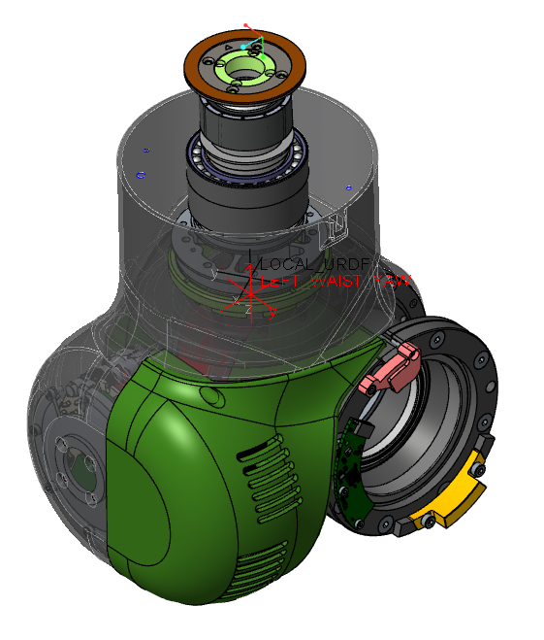
Hip Yaw
VOLUME = 5.8731346e+05 MM^3
SURFACE AREA = 4.3905301e+05 MM^2
AVERAGE DENSITY = 2.9719531e-06 KILOGRAM / MM^3
MASS = 1.7454681e+00 KILOGRAM
CENTER OF GRAVITY with respect to LEFT_WAIST_YAW coordinate frame:
X Y Z -2.1136410e+01 -4.2862386e+00 -3.8232267e+01 MM
INERTIA with respect to LEFT_WAIST_YAW coordinate frame: (KILOGRAM * MM^2)
INERTIA TENSOR:
Ixx Ixy Ixz 8.5691728e+03 -1.9828734e+02 -2.2121863e+03
Iyx Iyy Iyz -1.9828734e+02 9.9794948e+03 -4.0039407e+02
Izx Izy Izz -2.2121863e+03 -4.0039407e+02 5.2783547e+03
INERTIA at CENTER OF GRAVITY with respect to LEFT_WAIST_YAW coordinate frame: (KILOGRAM * MM^2)
INERTIA TENSOR:
Ixx Ixy Ixz 5.9857438e+03 -4.0155441e+01 -8.0168603e+02
Iyx Iyy Iyz -4.0155441e+01 6.6483492e+03 -1.1435964e+02
Izx Izy Izz -8.0168603e+02 -1.1435964e+02 4.4665032e+03
PRINCIPAL MOMENTS OF INERTIA: (KILOGRAM * MM^2)
I1 I2 I3 4.1159386e+03 6.3303225e+03 6.6543350e+03
ROTATION MATRIX from LEFT_WAIST_YAW orientation to PRINCIPAL AXES:
0.39448 0.91889 0.00466
0.04770 -0.02554 0.99854
0.91767 -0.39368 -0.05390
ROTATION ANGLES from LEFT_WAIST_YAW orientation to PRINCIPAL AXES (degrees):
angles about x y z -93.090 0.267 -66.766
RADII OF GYRATION with respect to PRINCIPAL AXES:
R1 R2 R3 4.8559979e+01 6.0222248e+01 6.1744229e+01 MM

Slide 6
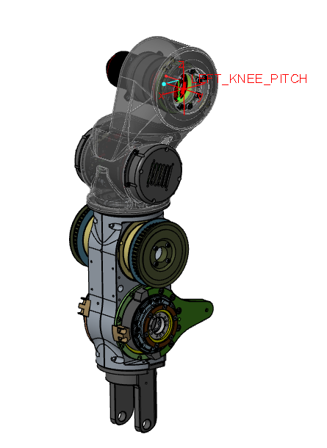
Knee Pitch
VOLUME = 1.2595184e+06 MM^3
SURFACE AREA = 8.5214192e+05 MM^2
AVERAGE DENSITY = 2.9388146e-06 KILOGRAM / MM^3
MASS = 3.7014912e+00 KILOGRAM
CENTER OF GRAVITY with respect to LEFT_KNEE_PITCH coordinate frame:
X Y Z 2.7363015e+01 -5.7802070e+01 -1.9306454e+02 MM
INERTIA with respect to LEFT_KNEE_PITCH coordinate frame: (KILOGRAM * MM^2)
INERTIA TENSOR:
Ixx Ixy Ixz 2.1500581e+05 6.2235688e+03 2.4925435e+04
Iyx Iyy Iyz 6.2235688e+03 2.0406399e+05 -4.4038890e+04
Izx Izy Izz 2.4925435e+04 -4.4038890e+04 2.3322675e+04
INERTIA at CENTER OF GRAVITY with respect to LEFT_KNEE_PITCH coordinate frame: (KILOGRAM * MM^2)
INERTIA TENSOR:
Ixx Ixy Ixz 6.4669769e+04 3.6914631e+02 5.3710941e+03
Iyx Iyy Iyz 3.6914631e+02 6.3323486e+04 -2.7319883e+03
Izx Izy Izz 5.3710941e+03 -2.7319883e+03 8.1842652e+03
PRINCIPAL MOMENTS OF INERTIA: (KILOGRAM * MM^2)
I1 I2 I3 7.5420492e+03 6.3452356e+04 6.5183114e+04
ROTATION MATRIX from LEFT_KNEE_PITCH orientation to PRINCIPAL AXES:
-0.09381 -0.05939 -0.99382
0.04932 0.99672 -0.06422
0.99437 -0.05504 -0.09057
ROTATION ANGLES from LEFT_KNEE_PITCH orientation to PRINCIPAL AXES (degrees):
angles about x y z 144.661 -83.625 147.662
RADII OF GYRATION with respect to PRINCIPAL AXES:
R1 R2 R3 4.5139456e+01 1.3092890e+02 1.3270253e+02 MM

Slide 7
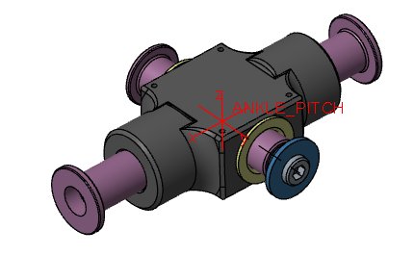
Ankle pitch
VOLUME = 4.2947161e+04 MM^3
SURFACE AREA = 2.1304412e+04 MM^2
AVERAGE DENSITY = 4.1268900e-06 KILOGRAM / MM^3
MASS = 1.7723821e-01 KILOGRAM
CENTER OF GRAVITY with respect to ANKLE_PITCH coordinate frame:
X Y Z 1.1213007e+00 4.6152281e-01 -1.1449670e-03 MM
INERTIA with respect to ANKLE_PITCH coordinate frame: (KILOGRAM * MM^2)
INERTIA TENSOR:
Ixx Ixy Ixz 2.8179788e+01 0.0000000e+00 0.0000000e+00
Iyx Iyy Iyz 0.0000000e+00 9.7601246e+01 4.6669685e-04
Izx Izy Izz 0.0000000e+00 4.6669685e-04 1.1596643e+02
INERTIA at CENTER OF GRAVITY with respect to ANKLE_PITCH coordinate frame: (KILOGRAM * MM^2)
INERTIA TENSOR:
Ixx Ixy Ixz 2.8142035e+01 9.1715528e-02 -2.1701012e-04
Iyx Iyy Iyz 9.1715528e-02 9.7378402e+01 3.7303915e-04
Izx Izy Izz -2.1701012e-04 3.7303915e-04 1.1570584e+02
PRINCIPAL MOMENTS OF INERTIA: (KILOGRAM * MM^2)
I1 I2 I3 2.8141914e+01 9.7378523e+01 1.1570584e+02
ROTATION MATRIX from ANKLE_PITCH orientation to PRINCIPAL AXES:
1.00000 0.00132 0.00000
-0.00132 1.00000 0.00002
0.00000 -0.00002 1.00000
ROTATION ANGLES from ANKLE_PITCH orientation to PRINCIPAL AXES (degrees):
angles about x y z 0.000 0.000 -0.076
RADII OF GYRATION with respect to PRINCIPAL AXES:
R1 R2 R3 1.2600801e+01 2.3439747e+01 2.5550474e+01 MM

Slide 8
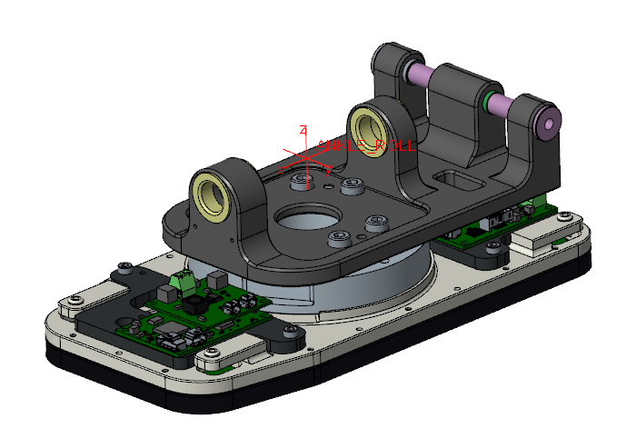
Ankle Roll
VOLUME = 4.6845665e+05 MM^3
SURFACE AREA = 1.9526772e+05 MM^2
AVERAGE DENSITY = 3.8038939e-06 KILOGRAM / MM^3
MASS = 1.7819594e+00 KILOGRAM
CENTER OF GRAVITY with respect to ANKLE_ROLL coordinate frame:
X Y Z -8.6960323e+00 -6.6741928e-02 -4.1675435e+01 MM
INERTIA with respect to ANKLE_ROLL coordinate frame: (KILOGRAM * MM^2)
INERTIA TENSOR:
Ixx Ixy Ixz 5.0132587e+03 4.7584269e+00 -3.1743614e+02
Iyx Iyy Iyz 4.7584269e+00 8.5816087e+03 -8.0083189e+00
Izx Izy Izz -3.1743614e+02 -8.0083189e+00 6.5411533e+03
INERTIA at CENTER OF GRAVITY with respect to ANKLE_ROLL coordinate frame: (KILOGRAM * MM^2)
INERTIA TENSOR:
Ixx Ixy Ixz 1.9182691e+03 5.7926583e+00 3.2836542e+02
Iyx Iyy Iyz 5.7926583e+00 5.3518735e+03 -3.0518008e+00
Izx Izy Izz 3.2836542e+02 -3.0518008e+00 6.4063918e+03
PRINCIPAL MOMENTS OF INERTIA: (KILOGRAM * MM^2)
I1 I2 I3 1.8943616e+03 5.3518775e+03 6.4302952e+03
ROTATION MATRIX from ANKLE_ROLL orientation to PRINCIPAL AXES:
0.99736 0.00191 0.07258
-0.00174 1.00000 -0.00243
-0.07258 0.00230 0.99736
ROTATION ANGLES from ANKLE_ROLL orientation to PRINCIPAL AXES (degrees):
angles about x y z 0.140 4.162 -0.110
RADII OF GYRATION with respect to PRINCIPAL AXES:
R1 R2 R3 3.2604875e+01 5.4802981e+01 6.0071234e+01 MM

Slide 9
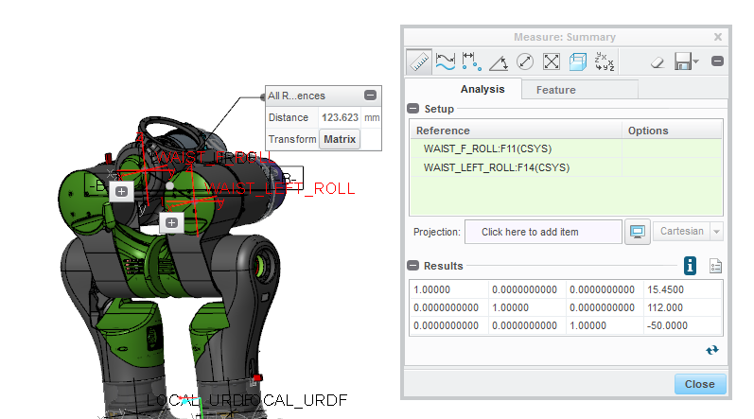
From waist to hip roll

Slide 10
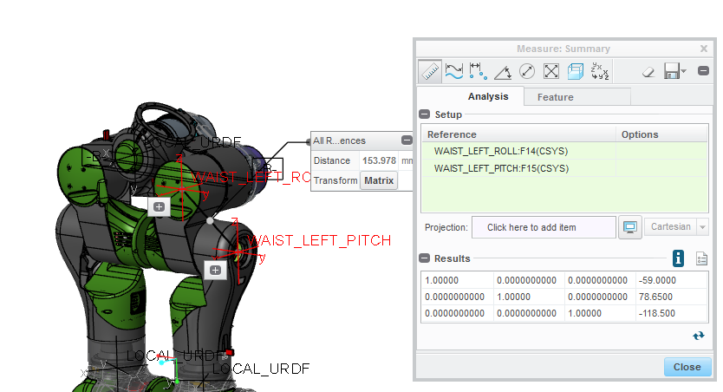
From hip-roll 2 hip-pitch

Slide 11
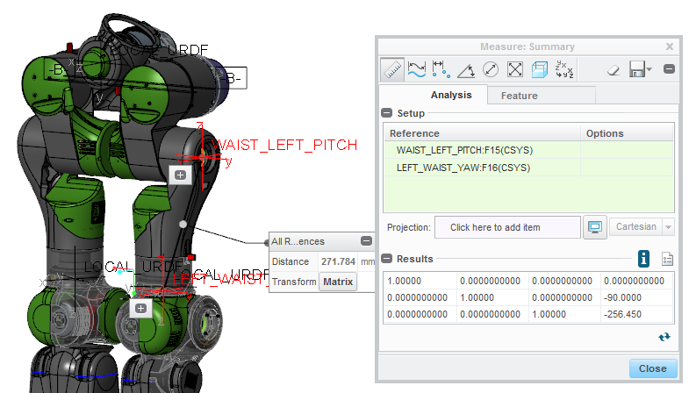
From hip-pitch 2 hip-yaw

Slide 12
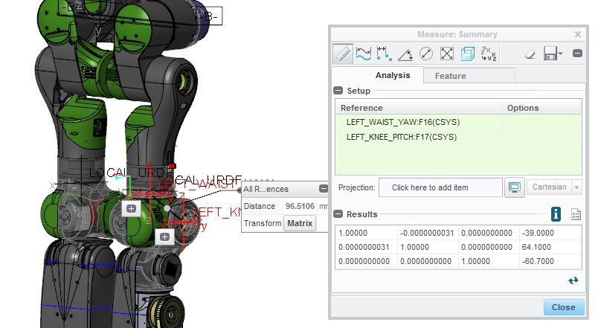
From hip-yaw 2 knee-pitch

Slide 13
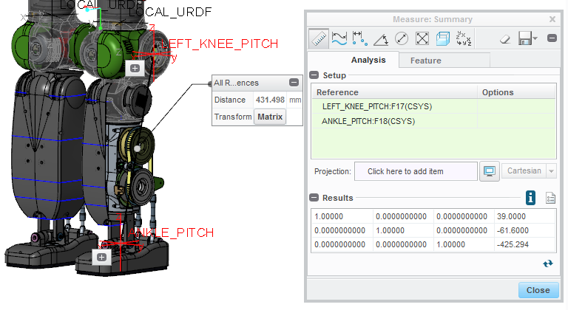
from Knee-pitch 2 ankle pitch

Slide 14
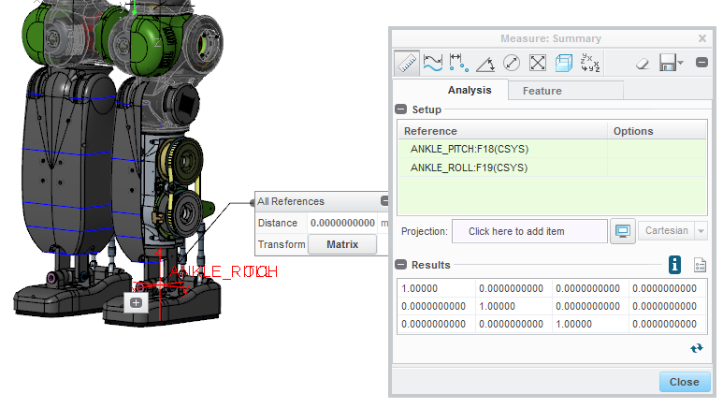
From ankle pitch 2 ankle roll

